Slide 1
Final Project
Amina Igibayeva, Mirolim Saidakhmatov

Slide 2
Outline
Topic
Outline
Dataset
4-6 EDA
7-8 Preprocessing
9-13 Machine Learning models
Conclusion

Slide 3
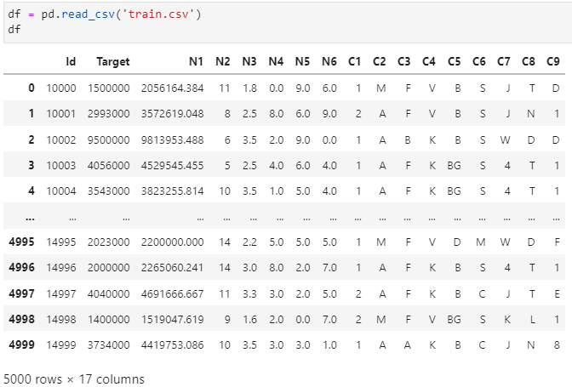
Dataset
Importing the dataset

Slide 4
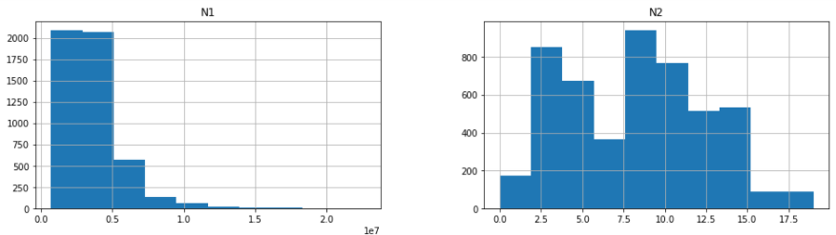
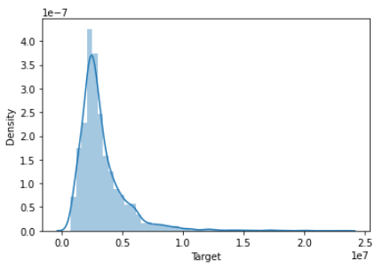
EDA
Distplot of the target
Histogram of numerical features

Slide 5
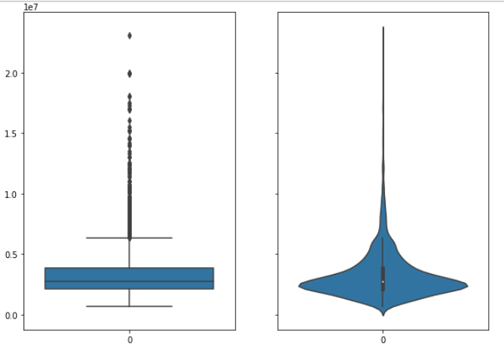
EDA
Boxplot and violinplot of the ‘Target’ column

Slide 6
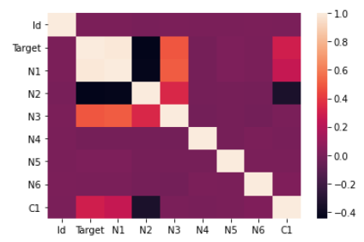
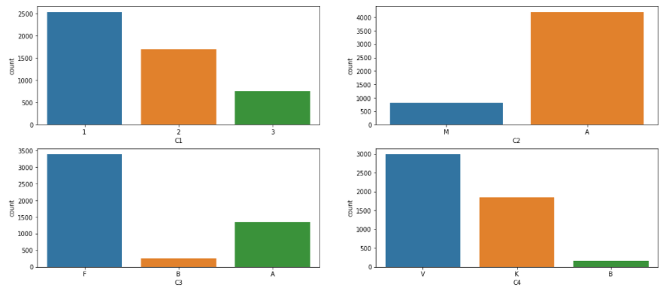
EDA
Showing countplot on categorical features
Heatmap of the correlation

Slide 7


Preprocessing
Encoding cat. features
Filling nans

Slide 8
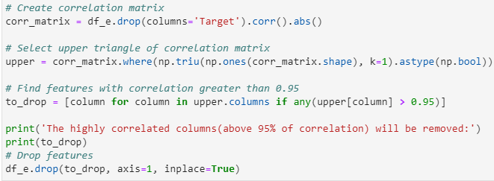
Finding correlation, and dropping highly correlated columns, above 95%

Slide 9
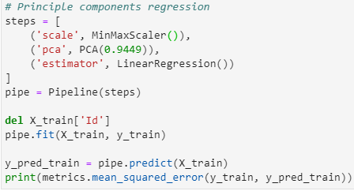
Predicting using regression Models: Linear Regression, Ridge and Lasso

Slide 10
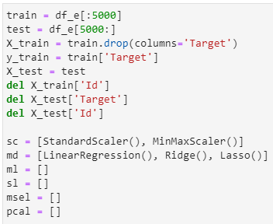
Train and test sets

Slide 11
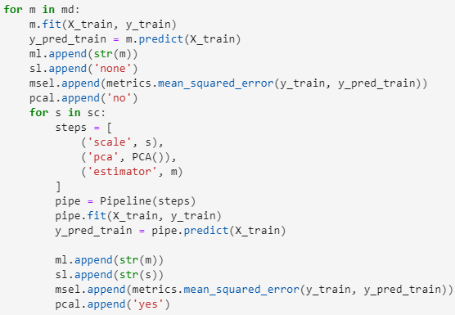
Running each model and storing them

Slide 12
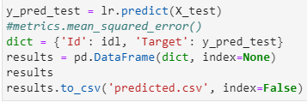
Predicting for test set and exporting to .csv

Slide 13
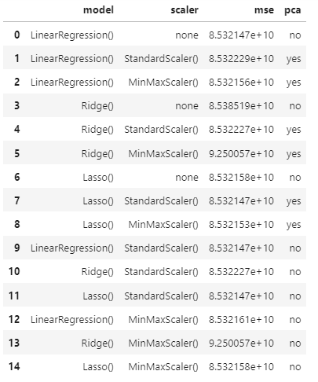
Evaluation metrics
The best accuracy score

Slide 14
Conclusion
We have seen cleaning, shaping, EDA, preprocessing and PCA on our data. Then we trained and tested our data on different models with different scalings:
-Linear Regression
-Ridge
-Lasso
And we have the best performance with Linear Regression.

